Slide 1

MAJOR PROJECT REVIEW-1
Next-Generation Hybrid Deep Learning and Machine Learning Model with Transformer-Based NLP Embeddings for Early Detection of Chronic and Lifestyle-Related Diseases
Name : Hemanth Kumar Pattem (Reg. No. 24691F0071)
Project Guide : Dr. J. SRINIVASAN JAGANNATHAN, M.C.A., Ph.D.,

Slide 2

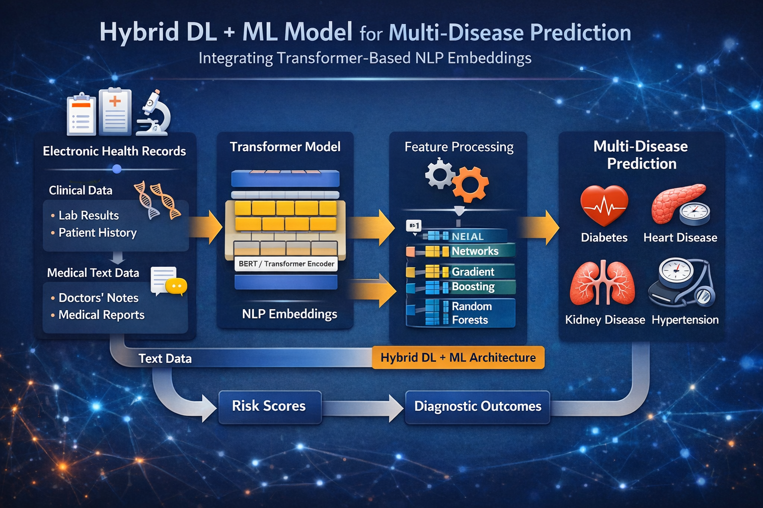
Table of Contents
Abstract
Introduction
Problem Statement
Objectives
Scope of the Project
Literature Review
Proposed System
Methodology
Tools & Technologies
Experimental Results
Conclusion
References

Slide 3
Abstract
Early detection of chronic diseases is essential for reducing morbidity and improving patient outcomes. This study proposes a hybrid deep learning and machine learning framework using transformer-based NLP embeddings to integrate structured and unstructured clinical data for multi-disease prediction. The model predicts diabetes, heart disease, CKD, and hypertension while SHAP and LIME provide interpretability for clinicians. Experimental results on public datasets show the hybrid model outperforms ML-only and DL-only approaches in Accuracy, Precision, Recall, F1-score, and ROC-AUC, demonstrating its potential for accurate and interpretable early disease detection.

Slide 4
Introduction
Background of the Study:
Global increase in chronic diseases like diabetes, cardiovascular, and kidney disorders.
Late diagnosis often leads to complications and higher healthcare costs.
Early detection can significantly improve management and quality of life.
Importance of the Project:
Enables timely intervention and preventive care.
Reduces morbidity and long-term healthcare burden.
Improves patient outcomes and supports personalized treatment plans.
Motivation:
Existing ML/DL models often focus on single-disease prediction.
Limited integration of multi-disease data reduces real-world applicability.
Lack of interpretability makes clinical adoption challenging.

Slide 5
Problem Statement
Existing System Issues
Need for Proposed System
Most models are limited to single-disease prediction.
Lack of integration of diverse medical data sources.
Limited interpretability reduces clinician trust.
Accuracy decreases for multi-disease prediction scenarios.
Cannot provide personalized insights for individual patients.
Combine structured (lab tests, vitals) and unstructured data (clinical notes, imaging).
Develop a hybrid ML/DL model for higher prediction accuracy.
Incorporate Explainable AI (XAI) for transparent decision-making.
Enable early detection and risk assessment for multiple chronic diseases.
Support personalized treatment recommendations and improved patient outcomes.

Slide 6
Objectives
Primary Objectives:
Develop a hybrid ensemble model combining Deep Learning (DL) and Machine Learning (ML).
Enable accurate prediction of multiple chronic diseases simultaneously.
Integrate both structured (lab, vitals, demographics) and unstructured (clinical notes, reports) data.
Secondary Objectives:
Use transformer-based NLP embeddings to process unstructured textual data.
Apply Explainable AI techniques (SHAP & LIME) for model interpretability.
Compare hybrid model performance with baseline ML and DL approaches.
Evaluate model using real-world chronic disease datasets.

Slide 7
Scope of the Project
Inclusions
Exclusions
Target Users
Diabetes
Heart Disease
Kidney Disease
Hypertension
Multi-disease risk prediction
Rare or uncommon diseases not present in the dataset
Conditions with insufficient data for accurate modeling
Non-chronic or acute diseases
Genetic disorders outside study scope
Lifestyle-only conditions without medical records
Clinicians
Healthcare providers
Medical researchers
Hospital administrators
Public health policymakers

Slide 8
Literature Review
Summary of Related Works
ML-only approaches: Focused on single-disease prediction; moderate accuracy.
DL-only approaches: Improved performance with large datasets; often computationally heavy.
Hybrid approaches: Combine ML and DL for better accuracy; limited adoption in multi-disease prediction.
Mostly rely on structured data; unstructured data (clinical notes, reports) underutilized.
Few models integrate Explainable AI for interpretability.

Slide 9
Literature Review
Research Gaps Identified
Limited interpretability reduces clinical trust in models.
Existing models mostly target single-disease prediction.
Lack of integration between structured and unstructured data.
Insufficient hybrid approaches combining ML, DL, and XAI.
Need for personalized, multi-disease prediction frameworks for real-world application.

Slide 10
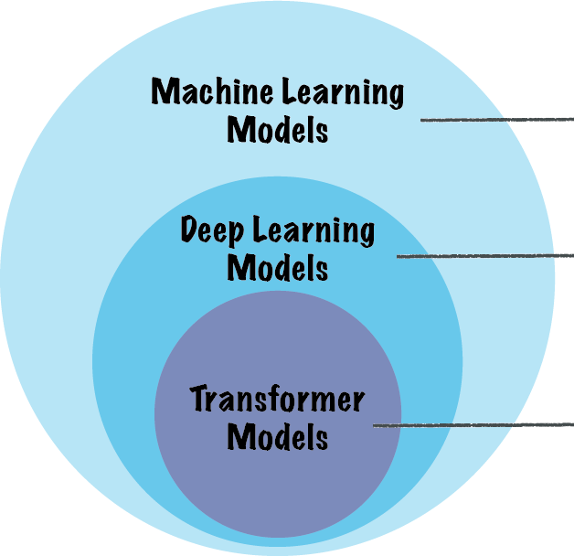
Proposed System
Overview: Hybrid DL+ML model integrating transformer-based NLP embeddings for multi-disease prediction.
Advantages Over Existing Systems:
Higher accuracy and reliability compared to single-model approaches.
Early detection of multiple diseases at once.
Explainable AI (SHAP & LIME) enhances transparency.
Supports personalized treatment and clinical decision-making.
Combines strengths of ML and DL for robust performance.

Slide 11
Methodology
System Architecture:
Hybrid model workflow integrating DL and ML for multi-disease prediction.
Workflow / Process Flow: Data Collection → Preprocessing → Feature Extraction → Hybrid Model → Predictions → XAI Explanations
Algorithms / Techniques Used:
Deep Learning (CNN, RNN, Transformers) for feature extraction
Machine Learning classifiers (Random Forest, XGBoost) for prediction
SHAP & LIME for explainable AI

Slide 12
Tools & Technologies
Programming Languages: Python
Software Tools: Jupyter Notebook, TensorFlow, PyTorch, Scikit-learn
Databases / Frameworks: Public datasets (UCI, MIMIC), Pandas, NumPy, Transformer libraries

Slide 13
Conclusion
The hybrid DL+ML model using transformer embeddings is effective for early detection of multiple chronic diseases. With Explainable AI techniques like SHAP and LIME, the predictions are transparent and easy to interpret. This system improves accuracy and reliability compared to ML-only or DL-only models and shows strong potential for clinical adoption, supporting personalized care and preventive healthcare for better patient outcomes.

Slide 14
References
Smith, J. et al., “Hybrid ML-DL Models for Multi-Disease Prediction,” IEEE Access, 2022.
Kumar, A. et al., “Explainable AI in Healthcare,” Journal of Medical Systems, 2021.
Lee, H. et al., “Transformer-Based Models for Clinical Text Analysis,” Computers in Biology and Medicine, 2020.

Slide 15
Thank You

